Slide 1
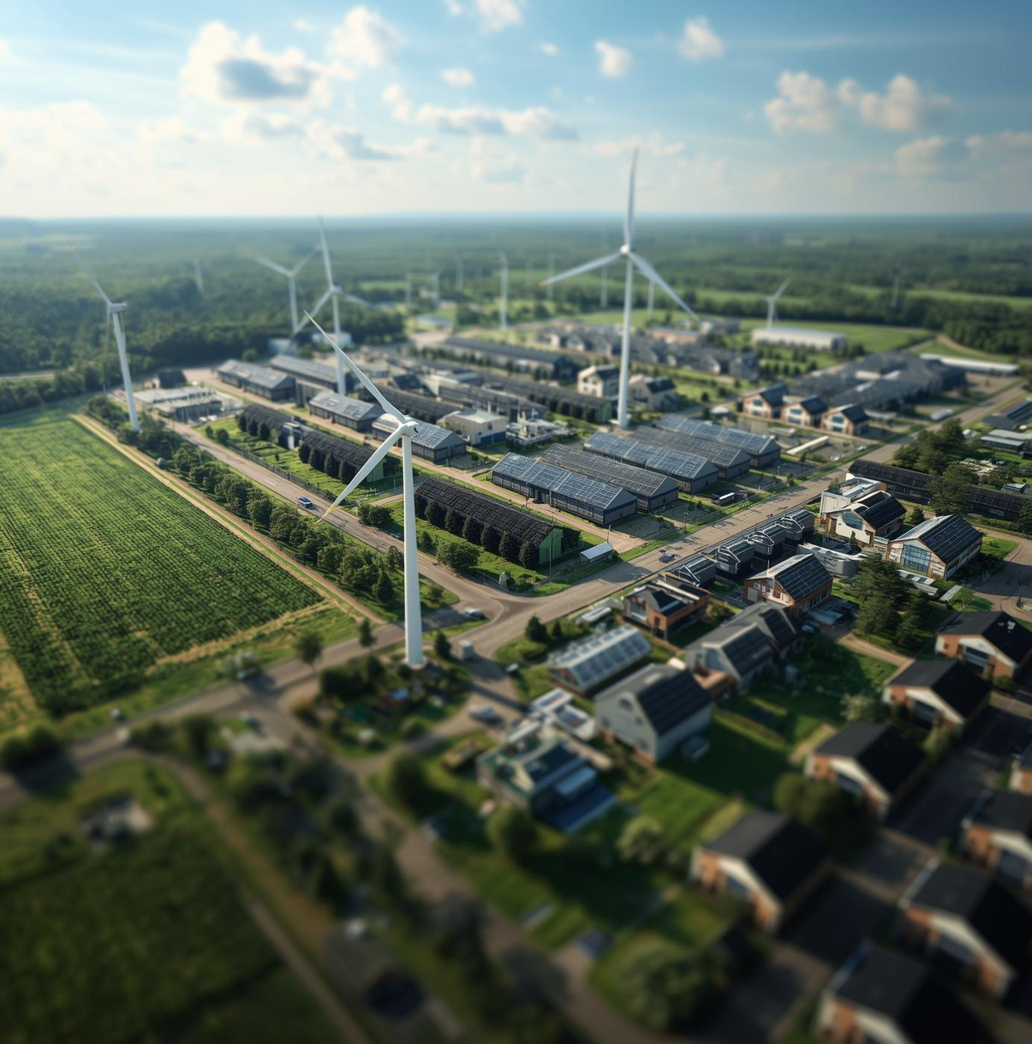
Hiring Now at Industrial Park Schwarze Pumpe (ISP)
INDUSTRIAL PARK SCHWARZE PUMPE
Presented by: Club 11
Chippy Chandra Pillai
Georgios Farfas
Samyuktha Alfred
Thasan Thamilarasan

Slide 2
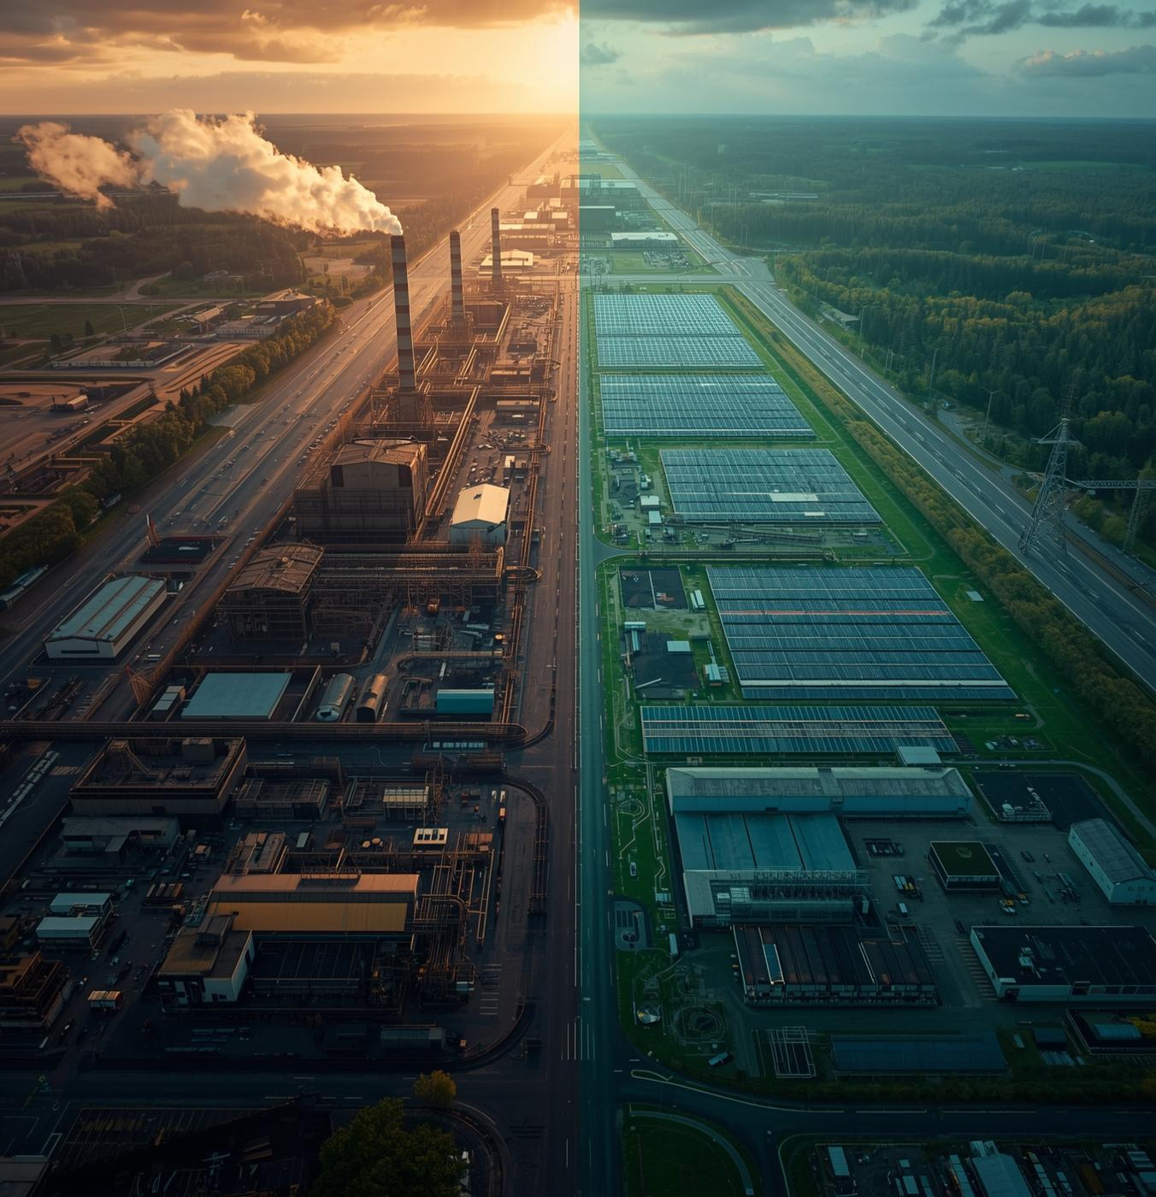
ISP’s Vision
Industrial Park Schwarze Pumpe is at the forefront of transforming the energy landscape in Lusatia, transitioning from coal dependency to a CO₂-neutral hub. This pivotal change aligns with Europe’s green energy revolution, positioning ISP as a leader in sustainable innovation.

Slide 3
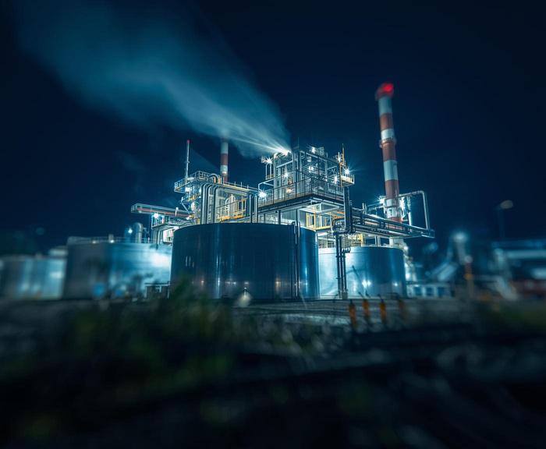
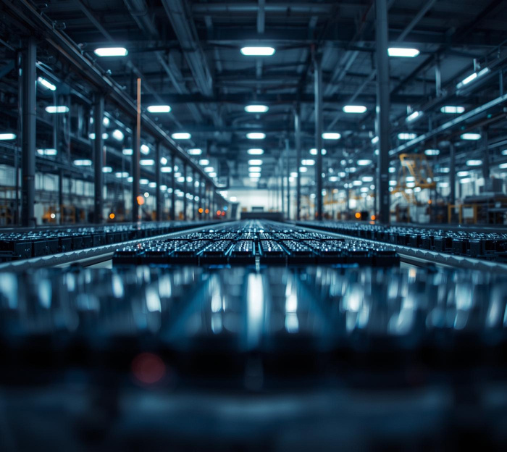
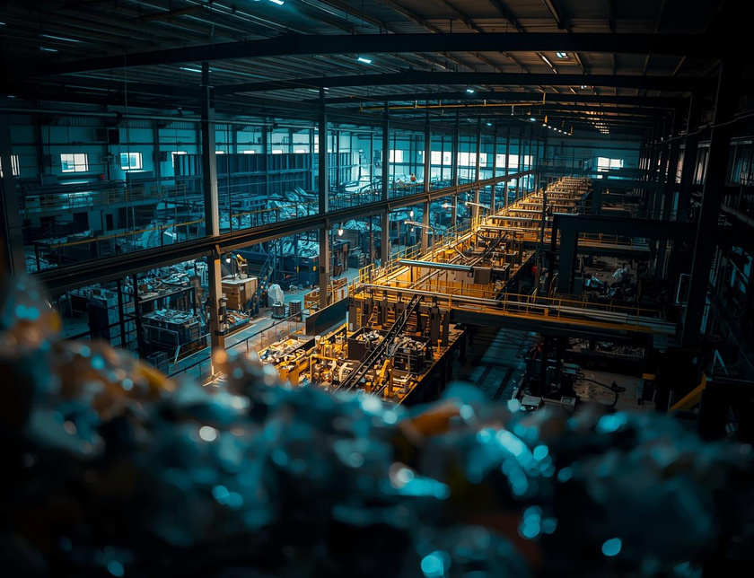
Flagship Green Energy Projects
Hydrogen
Batteries
Recycling
Pioneering sustainable energy through hydrogen production
Innovating energy storage for a greener future
Creating a circular economy through sustainable practices

Slide 4
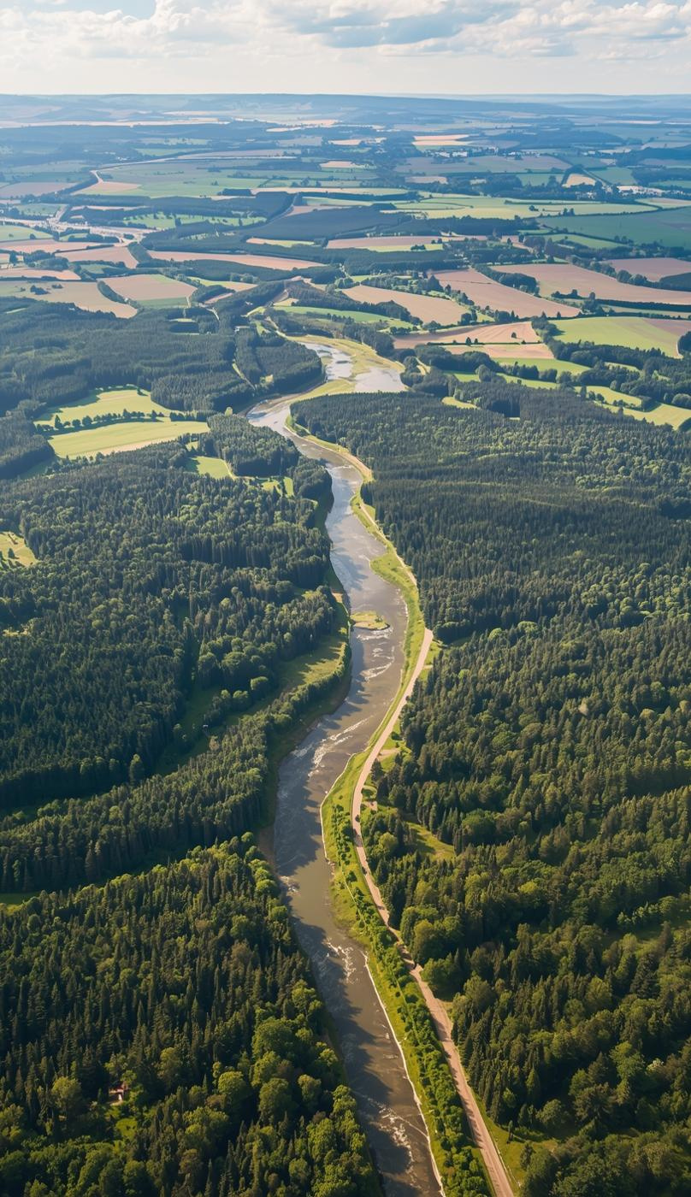
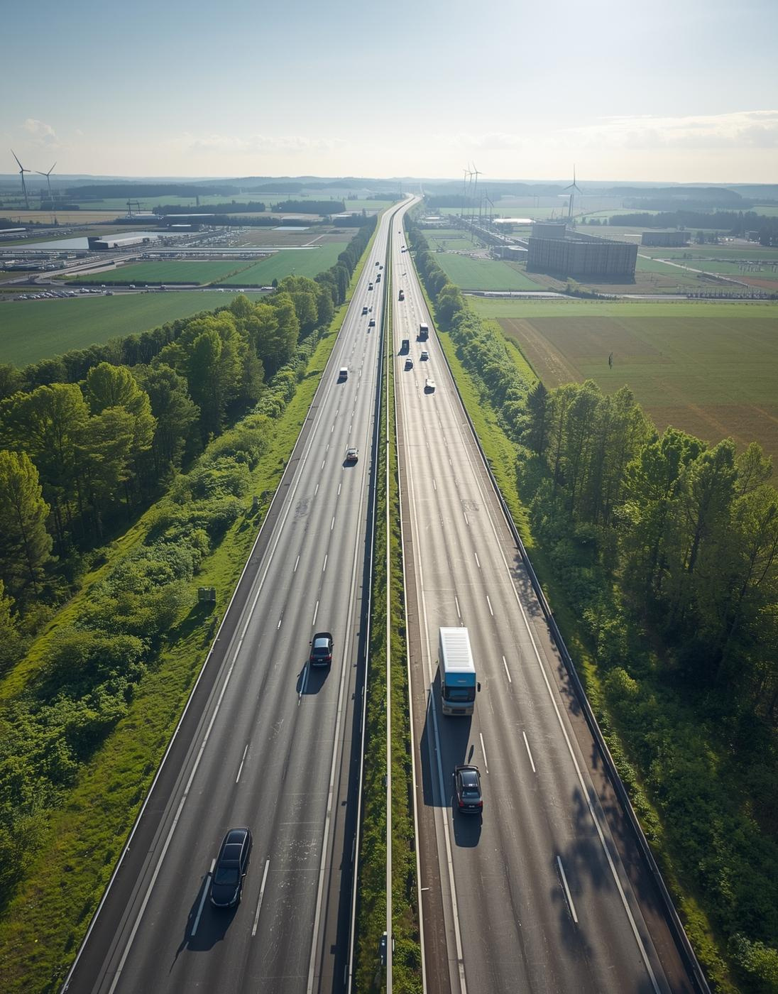
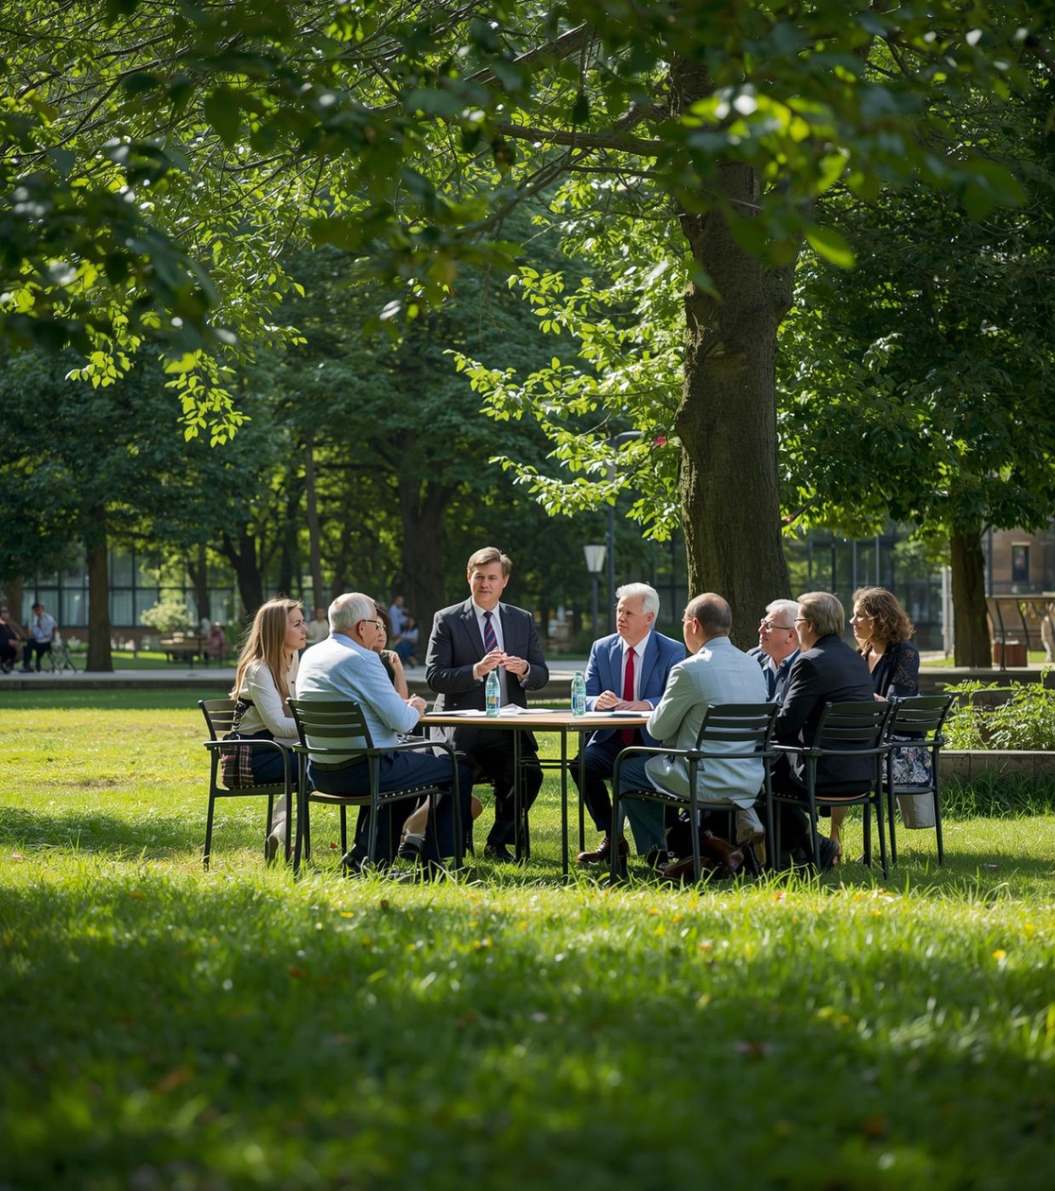
Lusatia's Advantages
Nature, Infrastructure, Support
Lusatia offers a unique blend of natural beauty, modern infrastructure, and government support, fostering a sustainable future.

Slide 5
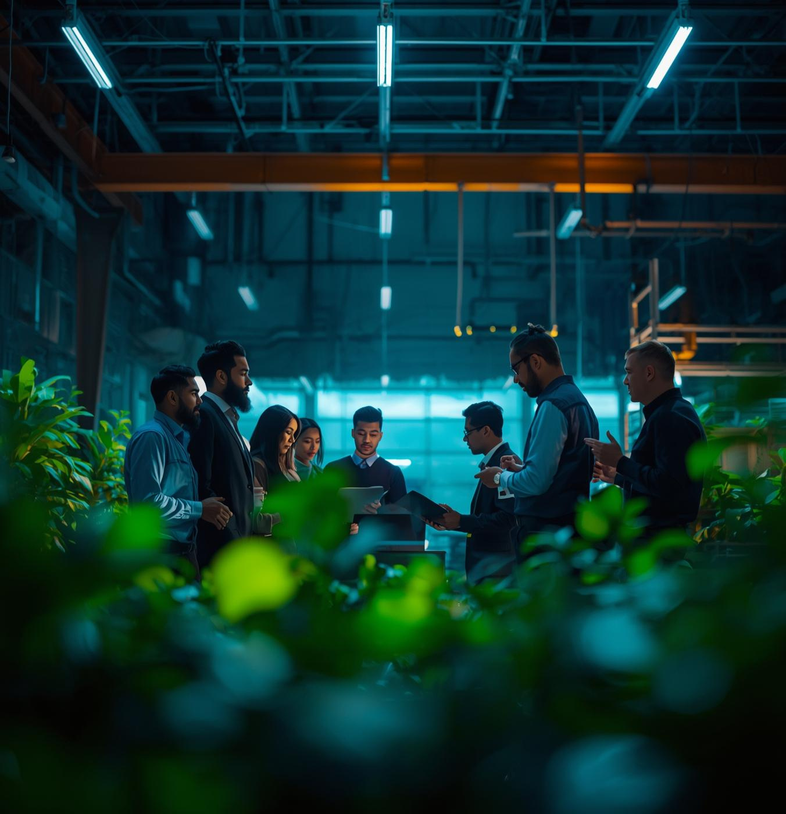
Talent Strategy
We need 1,500 international talents!
This is not just about filling jobs — it’s about building long-term lives in Lusatia.
Looking for
👩‍🔧 Engineers | 🧪 Researchers | 🧭 Specialists | 🎓 Graduates

Slide 6
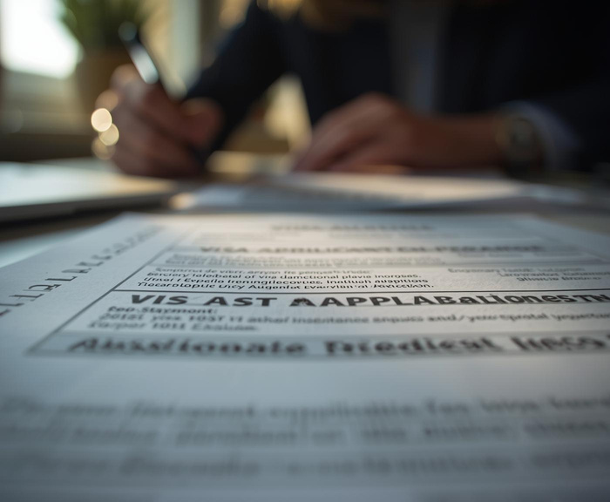
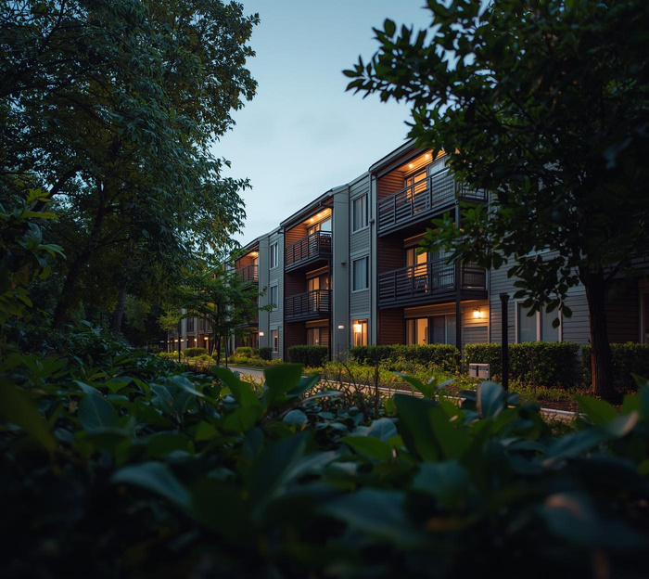

Holistic Relocation Support for International Talent
Seamless Relocation
Housing
Language
Comprehensive support for smooth relocation . dedicated team for visas, registration, banking, and housing.
Quality accommodations for a comfortable living experience
Free German lessons for you and your family

Slide 7
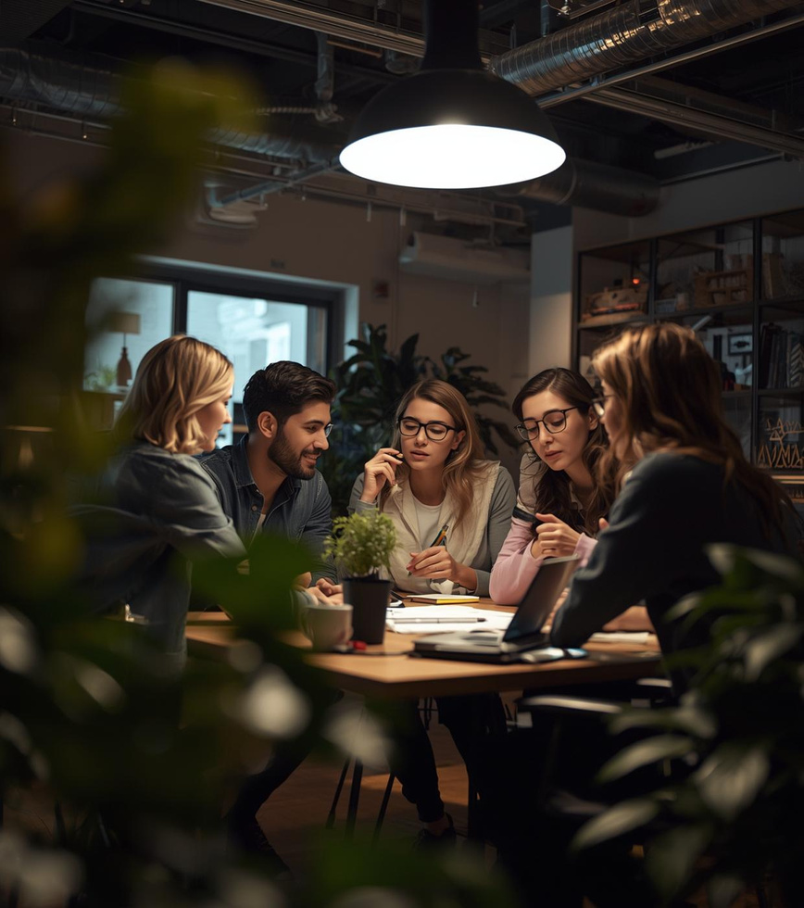


Integration & Inclusivity
Innovatrium Project & Diversity Commitment
Our Innovatrium Project fosters inclusivity, enhancing collaboration and creativity through diverse talent integration and support.

Slide 8
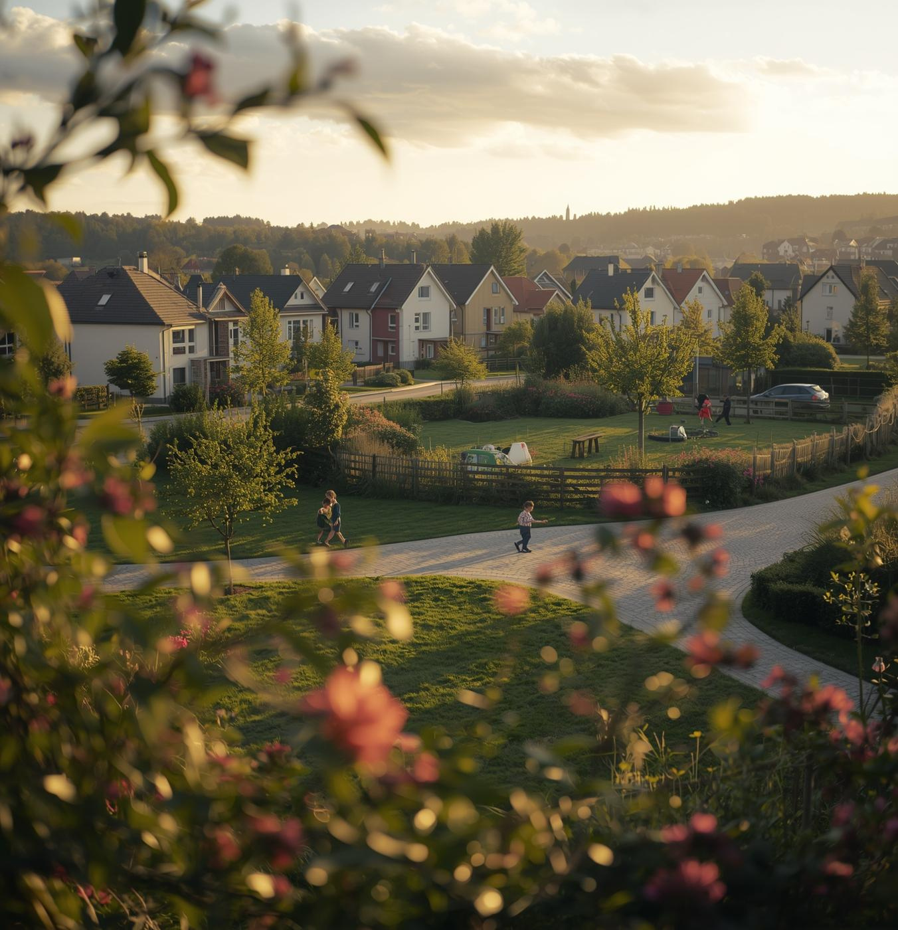
Competitive Advantages
ISP offers distinct benefits over major German cities, such as a lower cost of living, access to nature, and a family-friendly environment. This balance fosters a strong community, ensuring a high quality of life that attracts and retains top talent.

Slide 9

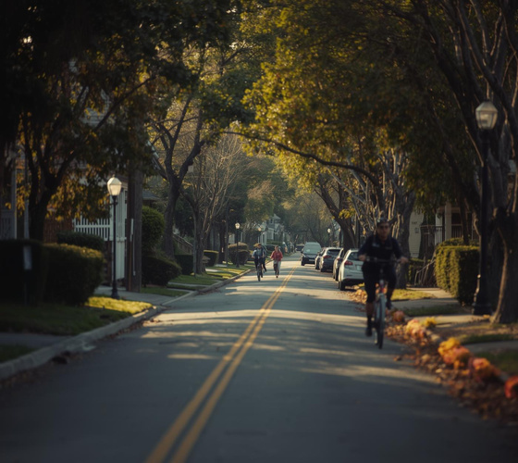
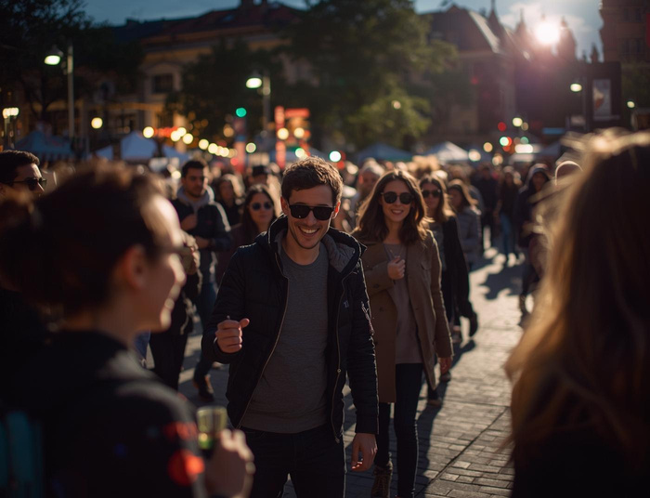
Lifestyle Benefits of ISP Living
Family
Safety
Community
A welcoming community ideal for families to thrive.
Safe, supportive, connected.
Engaging events that foster strong neighborhood bonds.

Slide 10
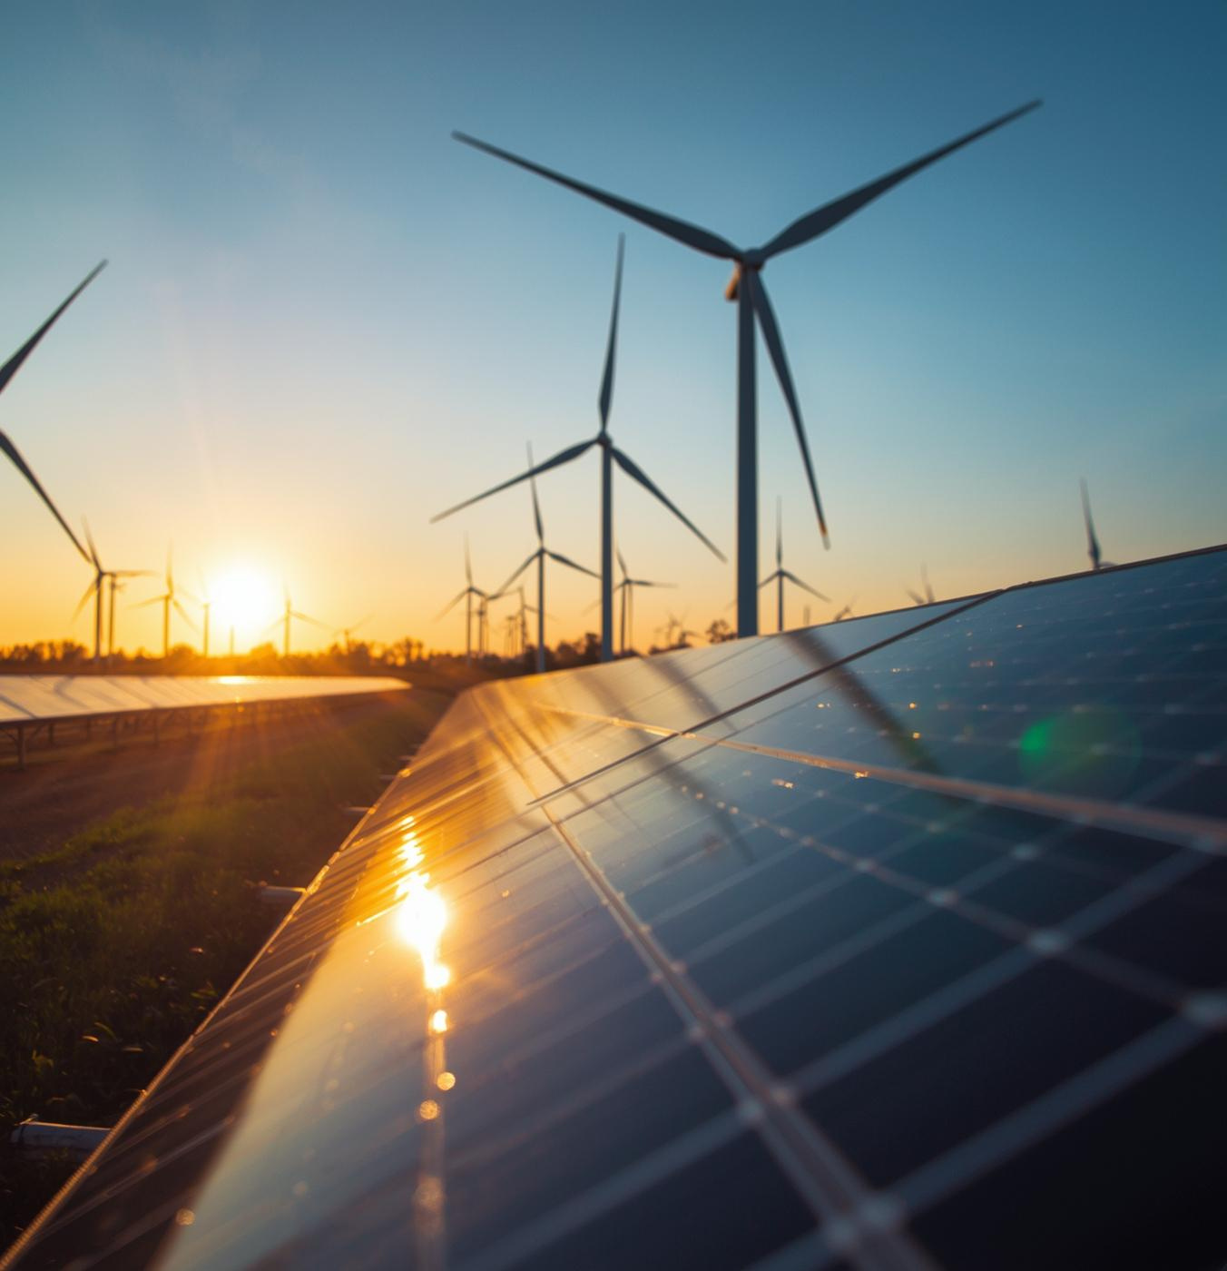
Why choose us?
ISP offers something unique:
✅ Lower cost of living
🌳 Direct access to nature
🤝 A close-knit community
🚀 Visible impact in a historic transformation

Slide 11
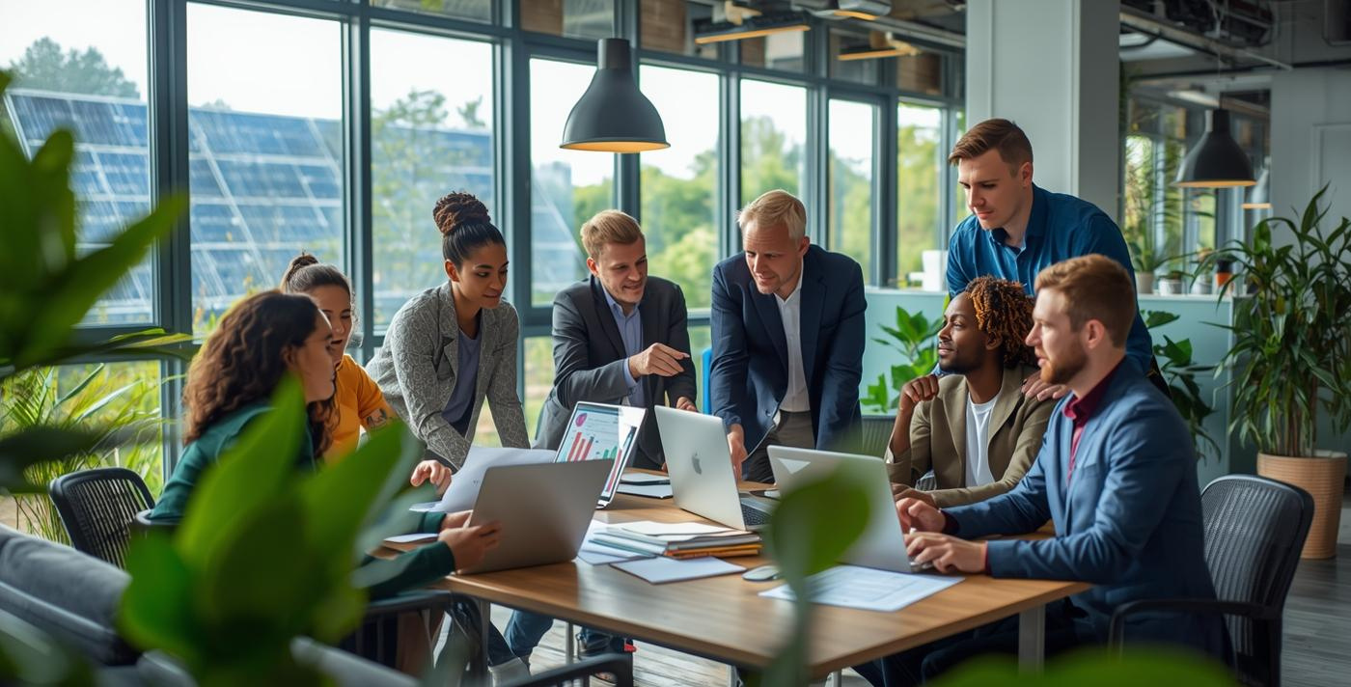
Join us on this journey!
Come to Industriepark Schwarze Pumpe.
Don’t just build your CV — build the future.
Don’t just find a job — find a home.

